Slide 1

Deep Learning-Driven Pest Detection and Classification with Instant SMS Alerts for Precision Agriculture
GUIDE
Mr. Ramesh R
Srinivasa Ramanujan Centre
SASTRA Deemed to be University
Presented By:
Ch. Hemanth Sai Nag – 226003030
D. Deepak Reddy – 226003039
G. Sai Aasish – 226003050

Slide 2
Contents
Base paper Title and Info
Abstract
Problem Statement
Literature Survey
Work Plan
Methodology Explanation
Architecture Diagram
Dataset description
Work Flow
Partial implementation (Completed modules 40% - demo and screen shot)

Slide 3
BASE PAPER DETAILS
Title : Pest classification: Explainable few-shot learning vs. convolutional neural networks vs. transfer learning.
Journal Name : SCI-E
Published Year : 2025

Slide 4
ABSTRACT
Detecting pests in agriculture under minimal labelled data and real-time constraints.
When the datasets are small, FSL will be applied for pest detection. For large datasets, Vision Transformers (ViT).
Graph Neural Networks (GNNs) will convert images into graphs and train the model.
Self-Supervised Learning will fine-tune performance with small datasets.
TensorFlow Lite will allow for optimized mobile inference and allow lightweight yet high performance pest detection.
OpenCV will process real time video feeds, allowing immediate analysis.
Integration with SMS notification is to ensure prompt action as this will notify the farmer about the activity of the pest.
The application combines deep learning with real-time processing, providing a very efficient and accurate method toward field-ready management of pests.

Slide 5
PROBLEM STATEMENT
Manual pest detection is slow, error-prone, and relies on expert knowledge, while existing AI models require large labeled datasets.
Conventional deep learning models struggle with accuracy in data-scarce environments and lack interpretability, making them difficult to trust.
Therefore, leverages Explainable Few-Shot Learning (FSL) to enhance pest classification accuracy, reduce data dependency, and provide transparent, trustworthy AI decisions.

Slide 6
OBJECTIVE
Develop and evaluate an Explainable Few-Shot Learning (FSL)-based pest classification system to improve accuracy, efficiency, and transparency in smart agriculture.
Compare FSL models with traditional deep learning approaches to achieve high classification accuracy with minimal data while integrating explainability techniques like Grad-CAM for better interpretability and trust.

Slide 7
LITERATURE REVIEW
Title | Author | Published Year | Methodology | Journal | Merits | Demerits
1. Detection of mulberry ripeness stages using deep learning models | Seyed-Hassan Miraei Ashtiani | 2021 | The study employs deep learning models, specifically Convolutional Neural Networks (CNNs), to classify mulberry ripeness stages based on image data. | IEEE | The proposed CNN-based approach achieves high accuracy in classifying mulberry ripeness stages, demonstrating the effectiveness of deep learning in agricultural applications. | The study may face challenges related to the generalization of the model to different environmental conditions and the need for a large dataset to train the deep learning model effectively

Slide 8
Title | Author | Published Year | Methodology | Journal | Merits | Demerits
Machine Learning based Pest Identification in Paddy Plants. | Vivek Agnihotri | 2019 | The authors propose an OTA-C (Operational Transconductance | IEEE | The proposed design offers a flexible approach to implementing fractional-order filters. | The practical implementation of fractional-order capacitors can be challenging.
AMN: Attention Metric Network for One-Shot Remote Sensing Image Scene Classification. | Yonghao Xu | 2020 | The authors propose the Attention Metric Network (AMN), a deep learning model. | Remote Sensing | The AMN model enhances feature representation by focusing on the most relevant parts of an image | The study may face challenges in generalizing the model to diverse remote sensing datasets due to potential overfitting.

Slide 9
Title | Author | Published Year | Methodology | Journal | Merits | Demerits
Multi-Domain Few-Shot Learning and Dataset for Agricultural Applications | Sai Vidyaranya Nuthalapati | 2021 | Introduces a group-aware contrastive network using context graphs. | IEEE | One merit of this method could be its innovative approach to person re-identification using group-aware contrastive networks. | A potential demerit could be the complexity of implementing and fine-tuning such a specialized network
Insect Pest Detection and Identification Method Based on Deep Learning for Realizing a Pest Control System | Hiroaki Kuzuhara | 2020 | The authors propose a two-stage detection and identification method for small insect pests utilizing Convolutional Neural Networks (CNNs). | SCI-E | A significant advantage of this method is its ability to accurately detect and identify small insect pests, which are often challenging to recognize. | A potential drawback is that the two-stage process may result in increased computational complexity and longer processing times.

Slide 10
Title | Author | Published Year | Methodology | Journal | Merits | Demerits
Few-shot learning for image-based bridge damage detection | Yan Gao | 2023 | Few Shot learning | Elsevier | Train model with few number of images | It’s not sure we can get more accuracy than general deep learning model.
Crop pest classification based on deep convolutional neural network and transfer learning | K. Thenmozhi | 2019 | Convolution Neural Network(CNN) | Elsevier | Training is very easy to implement. | We can’t get best efficiency by this model

Slide 11
Title | Author | Published Year | Methodology | Journal | Merits | Demerits
Vision transformer-based visual language understanding of the construction process | Bin Yang | 2024 | Vision transformer | Elsevier | Vision Transformers apply this architecture to image data, treating the image as a sequence of patches instead of a grid of pixels. | They still underperform CNNs when training data is very limited. Without sufficient data, the attention model tends to overfit.

Slide 12
Work Plan
Timeline/ Process | 1-10 days | 10-20 days | 20-30 days | 30-45 days | 45-60 days
Data Collection
Data Pre-processing
Split the data
Train FSL, GNN, Vit
Train SSL and combine model
OpenCV
Final Output

Slide 13
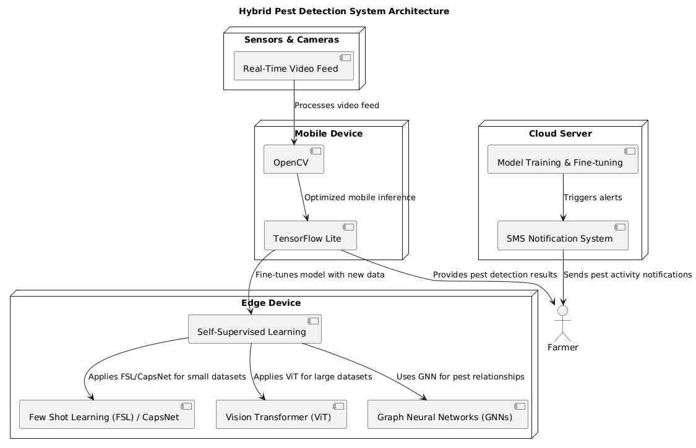
ARCHITECTURE DIAGRAM

Slide 14
Dataset Description
pest/
│── train/
|-aphids
|- armyworm
|- beetle
|- bollworm
|- grasshopper
|- mites
|- mosquito
|- sawfly
|- stem borer
│── test/
|-aphids
|- armyworm
|- beetle
|- bollworm
|- grasshopper
|- mites
|- mosquito
|- sawfly
|- stem borer

Slide 15
WORK FLOW DIAGRAM
Data Collection
Split the data
Train Individual model
Train combine model
Compare model

Slide 16
Evaluate model
Integrating Camera
Final Output

Slide 17
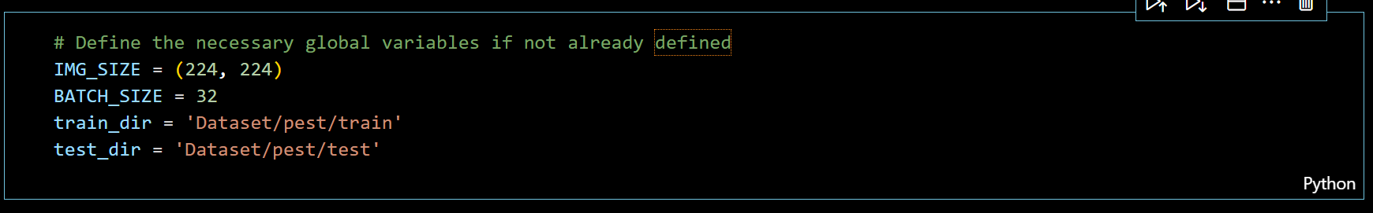
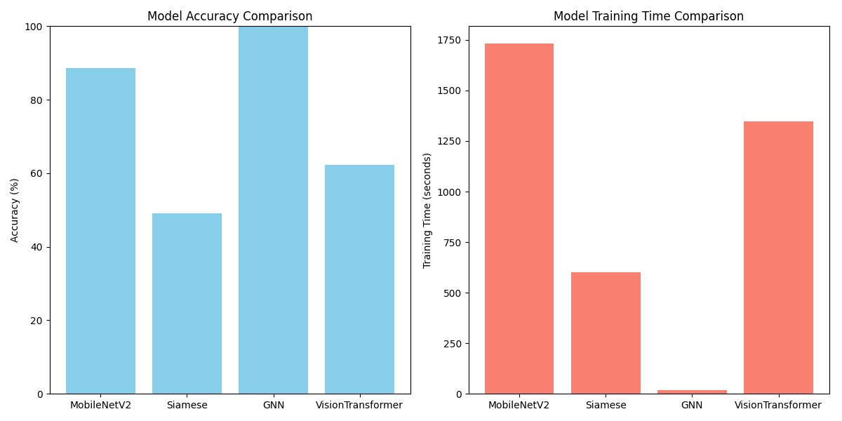
PARTIAL IMPLEMENTATION

Slide 18
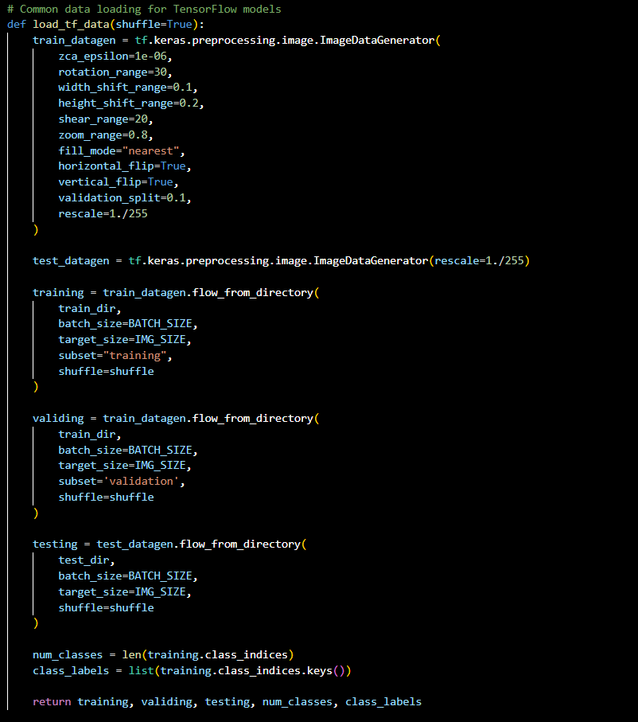
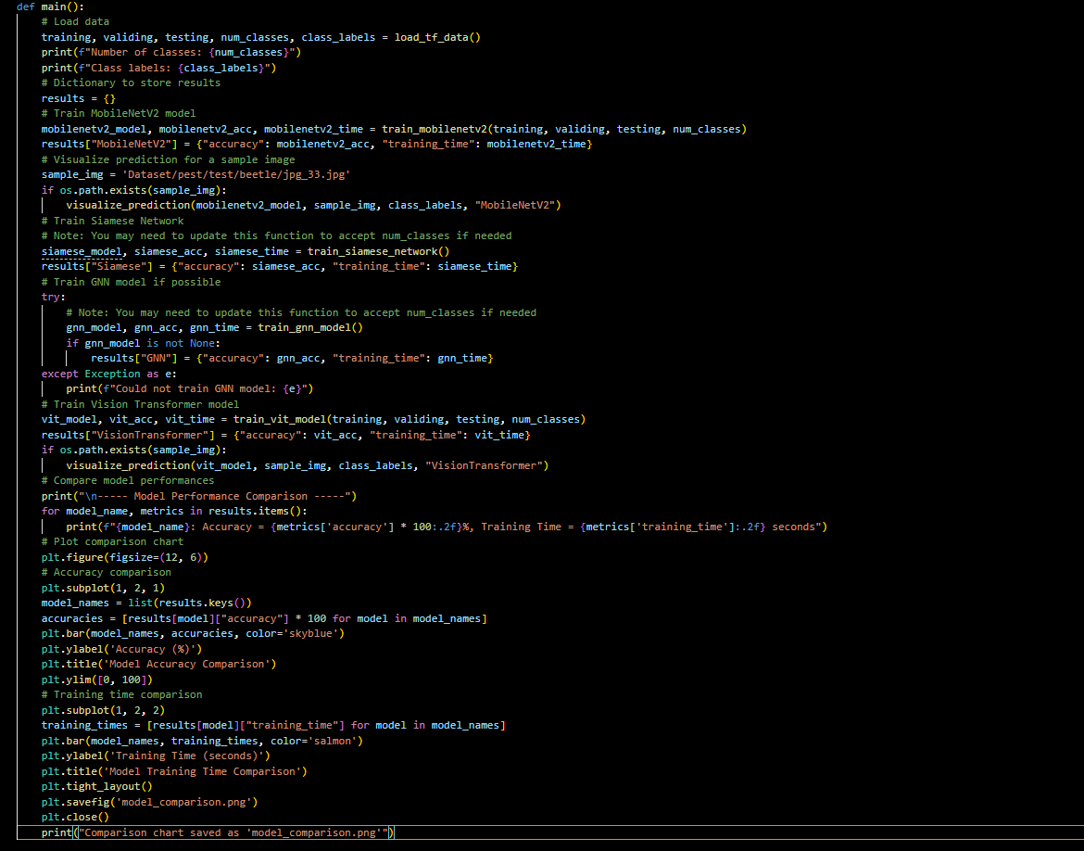

Slide 19
MODULES USED
Load TensorFlow data
Build mobilenetv2 model, train mobilenetv2 model
Euclidean distance, build Siamese base, build Siamese model,
Create pair, load image from directory.
Prepare pair of models, classify with Siamese, train Siamese network
Train GNN model.
Vit model.
Main module

Slide 20
THANK YOU!!

